Slide 1

API & Developer Tools
Introduction
October 2017

Slide 3
Introduction
The Test SLATE Application Programming Interface (API) was developed for Test SLATE Version 12 and is supported in all later versions. It is a long term solution for a Test SLATE API that includes expanded functionality, easier development, and better API documentation.
Powerful tools for Developers
Supports development of Custom Data Source Plug-ins

Slide 4
LabVIEW Integration Tools
API &Palettes
Create Project
Data Source Template
Main Menu Additions
System Explorer Nodes
SubSystem Level Editor
Configuration Level Editor
Source Run-Time
Build Scripts and Specifications

Slide 5
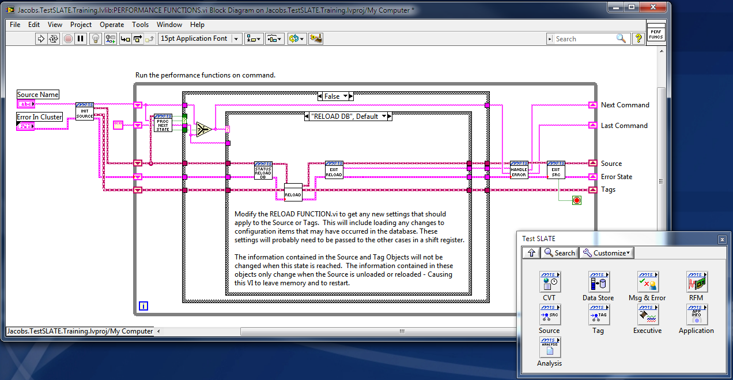
Test SLATE API
LabVIEW Integration Overview

Slide 6
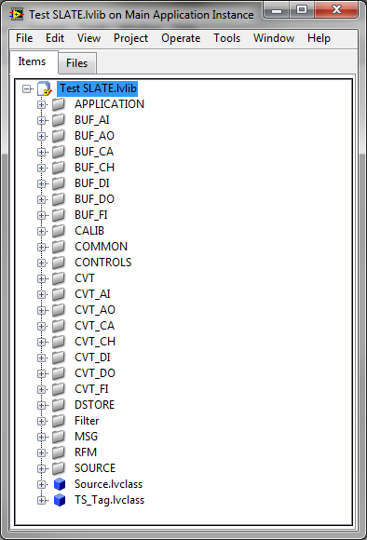
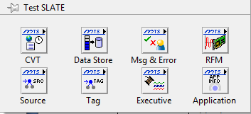
LabVIEW Integration – API & Palettes
Test SLATE API
Test SLATE.lvlib Library added to vi.lib
Contains interface code for Test SLATE
Integrated into LabVIEW Functions Palette

Slide 7
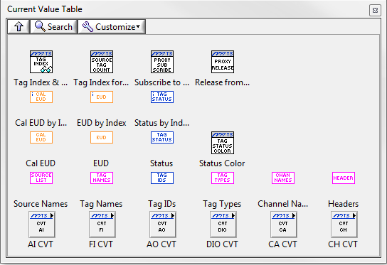
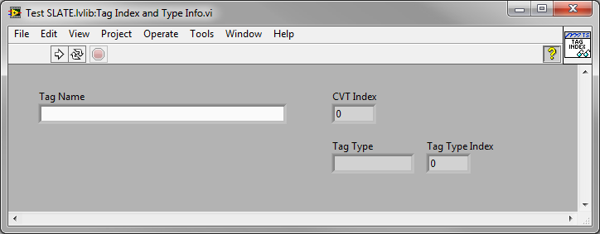
CVT Palette
Current Value Table access (All or by Data Type)
Data and Conversion Information
Index Information provided by Tag Index and Type Info.vi

Slide 8
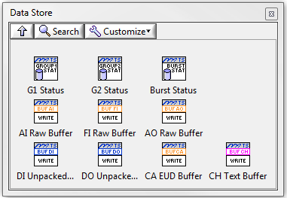
Data Storage Palette
Current Group and Burst Status
Source communication to Circular Buffers

Slide 9
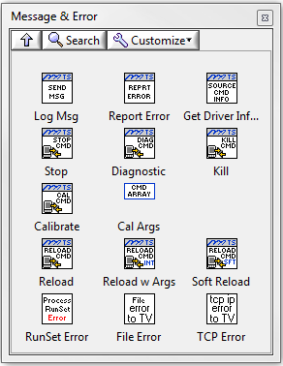
Message & Error Palette
Communicate to the Message Log
Send Message
Error Handling
Source Commands
Stop, Calibrate, Reload, etc

Slide 10
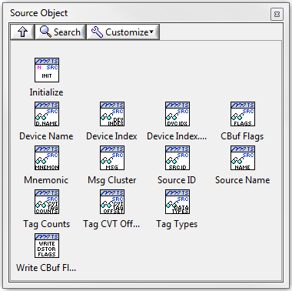
Source Object Palette
Source Objects contain Source settings
Source Name, Channel Types, CVT Index, Data Storage Settings
Use Initialize function to create
Automatically generated when using the Template

Slide 11
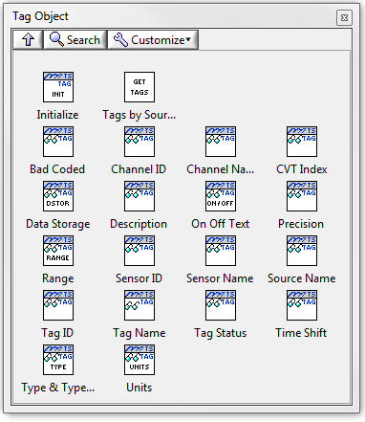
Tag Object Palette
Tag Objects contain Tag specific settings
Name, Status, TagID, Channel ID, Sensor, etc
Use Initialize function to create
Automatically generated when using the Template

Slide 12
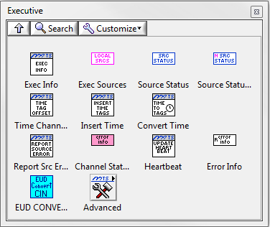
Executive Palette
Tools commonly needed by Sources during RunTime.
Supports the Template
Includes Source Status, Time Tag Interfaces, and Source Error Handling

Slide 13
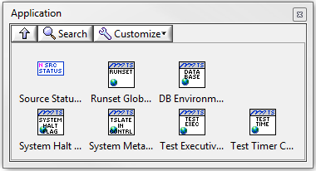
Application Palette
Contains global information about Test SLATE
Runset and Database .NET connections
System Halt Flag and other application globals

Slide 14
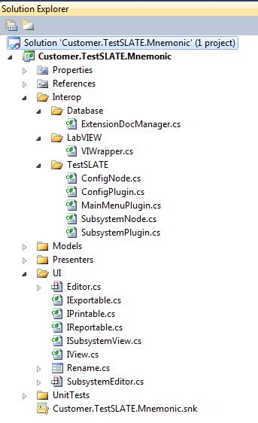
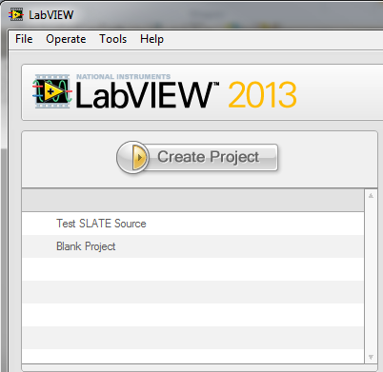
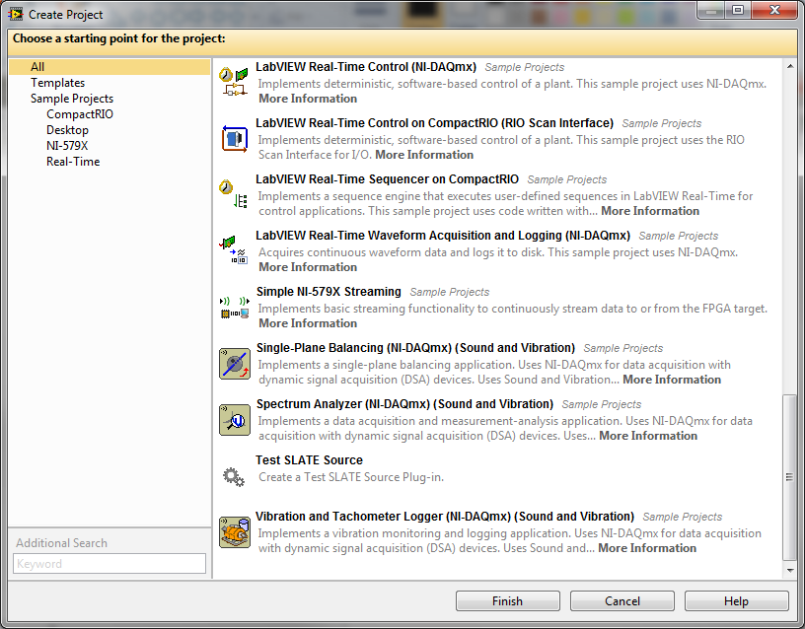
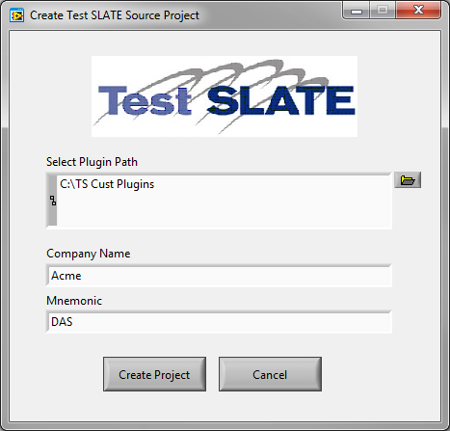
Test SLATE API Training
Source Template Overview

Slide 15
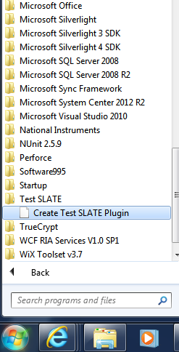
Source Template
Automatically generates a functional C# and LabVIEW Source
Generate from Windows Start Menu or via the LabVIEW Create Project Interface
Programmer Reference Instructions located in the Doc folder of the Template

Slide 16
Visual Studio Solution – Example Content
Link to Test SLATE
Add nodes to the System Explorer
Create Source Editor
Create Configuration-level Editor
Create Main Menu Items

Slide 17
Visual Studio Solution – Example Interfaces
Version Definition
Database (including Command Delivery)
Message Log
User Permissions
Calling LabVIEW
Debugging

Slide 18
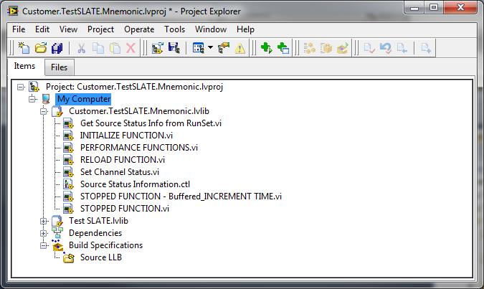
LabVIEW Project – Example Content
Main VI (Performance Functions)
Loading and Reloading
Initialization
Data Collection and Control

Slide 19
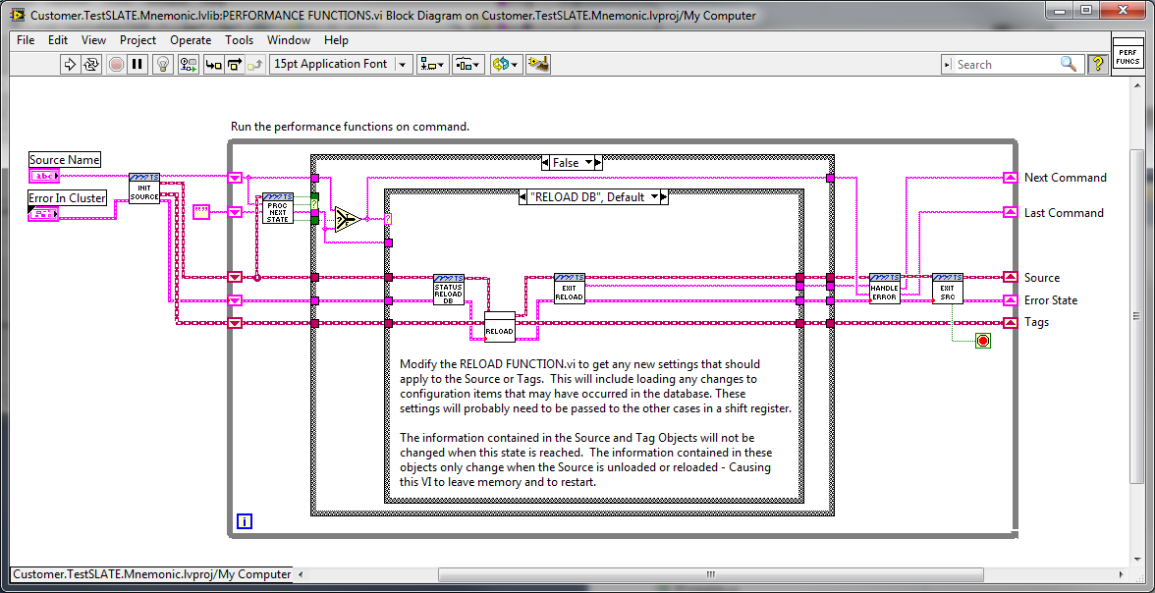
LabVIEW Project – Example Interfaces
Database
RunSet
Message Log
CVT
Data Storage
Time Tags
Channel Status
Source Status
Commands

Slide 20
Build Scripts and Specifications
The individual template items include Build information
Visual Studio Solution Build Properties
LabVIEW Build Specification
Powershell Automated Build Scripts included
Runs both Visual Studio and LabVIEW Builds
Incorporates pdf Help documents to final bin
Build.ps1 and Default.ps1

Slide 21
Summary
Developers now have more examples and the ability to create Custom Plugins via a defined interface
As we go through the rest of the training we will spend time looking at each of these topics in more detail

Slide 22
Test SLATE API Training
Test SLATE Application Space
Test SLATE Core
Calculations
Calibrations
Communications
Configuration Tools
Data Analysis
Data Storage
Database Management
Diagnostics
Displays*
Filter, Post Point, Post Test
Health Monitoring
Licensing
Menus
Message Logging
OPC
Reflective Memory Manager
Security
Test Execution
Test Sequencing
etc
Optional Plug-Ins
NI-DAQmx
Neff 470
etc
Optional Independent Functions
OPC Servers
HMI Interface
etc
Customer Plug-Ins
Plug-In #1
Plug-In #2
Customer Independent Functions
Function #1
Function #2
Test SLATE Interfaces

Slide 23
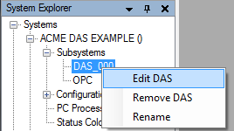
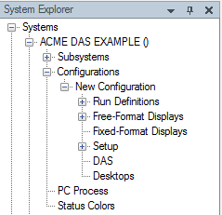
System Explorer
System Configuration is performed using the System Explorer tree
Plug-Ins can add items and context menus to new and existing nodes
Nodes are added via the IPlugin interface
Paths match the naming of the Nodes
Standard wording should be maintained
New, Edit, Remove, Delete, Rename, Refresh
Context Menu
Node = SystemExplorer/Configuration/DAS

Slide 24
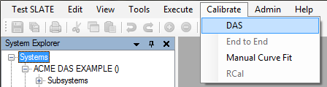
Main Menu
Available for extension:
Test SLATE
Edit
View
Tools
Data Analysis
Execute
Calibration
Help
Main Menu is used for general functions that are one or more of the following:
Independent of specific Configuration Editing
Only available at Run Time
Global functions such as Copy, Paste, Administration, and Help
To programmatically add:
Inherit from the MenuPlugIn
Set your parentMenu field to a Jacobs.TestSLATE.UX.Core.Properties.Resources.uxMenu item

Slide 25
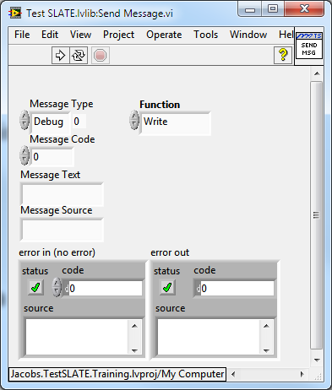
Message Logging
The Test SLATE Message Log is only available when the MOC is up and running. APIs are available through .NET, LabVIEW, and C/C++.
.Net
IMessageLog interface in
Jacobs.TestSLATE.Messaging
LabVIEW
Send Message.vi
C/C++
Available for external applications to send messages to the log. Contact Jacobs for this interface.
Custom Message Codes can be added.

Slide 26
Commands
TCP/IP is the command delivery method
Each process (Source, etc) is assigned a unique Process ID
assigned arbitrarily in multiples of 10000
defined in the TV.Mnemonics table
Function Word contains the command information
generated based on two items: Process ID and Command ID
Custom Command IDs can be defined
Arguments are used to pass special settings and information with a command
Function Word (I32)
Requestor ID
Source ID
Command Bytes
Argument 0
Argument N-1
Fixed-length portion
Variable-length portion

Slide 27
Commands - Standard
Stop | Used to exit Acquire, Diagnostics, or Calibration and return to Idle Mode.
Diagnostic | Used to Exit idle mode and collect data for Diagnostics. When in this mode, the source is reserved. It will not accept commands for acquire, calibrations, etc. The Stop command is used to exit this mode.
Kill | Used to stop collecting data and enter inactive mode. Only accepted when in idle mode.
Calibrate | Used to Exit idle mode and collect data for calibration. When in this mode, the source is reserved. It will not accept commands for acquire, diagnostics, etc. The Stop command is used to exit this mode.
Reload | Used to send the Source to the INIT state.
Soft Reload | Sends a Soft Reload Command to the requested Source Names. In addition to the Sources receiving the Soft Reloads, all other Test SLATE components will be notified that new conversion information may be available.

Slide 28
Security and User Permissions
Test SLATE security is governed by roles and users
Roles can allow access to functions using Security Options
Plug-ins can add additional Security Options at the Main Menu or System Explorer levels

Slide 29
Status
The Health Monitor (HM) Source and Test SLATE core provide the reporting and user interface functionality for the status information
Heartbeat Check
Source Status
Tag & Channel Status
Channel and Tag Reporting
HM Sends messages to the Message Log at a one-minute interval to report that a condition is active.
HM will also report a status cleared message upon transition to low for each bit.
Bad Coded Tags are not monitored and reported by the Health Monitor.
Each display will display a color that is user-specified using the Status Color Editor when a condition. The Bad Coded Status takes precedence, followed by NaN, and then each remaining status in bit order.
Each Test SLATE Source is responsible for providing its status to Test SLATE at its regular update interval.

Slide 30
Source Status
Status | Description | LabVIEW Global Location
Heartbeat | At each Source update interval, the Source indicates that it is currently running by incrementing the heartbeat value. | Status Globals Exec.vi: Heartbeat
System Status | The current state and error status for the Source. | Status Globals Exec.vi: System Status, Health Monitor Global Exec.vi: Various
Reload Date and TIme | The last time the Source performed a load or reload. | Status Globals Exec.vi: Reload…
Number of Chassis and Tags | The number of hardware chassis and tags the Source is currently using, if applicable | Status Globals Exec.vi: # Chassis, Channel Counts

Slide 31
System Status
Item | Description | LabVIEW Global Location
Acquiring | Source is collecting data for a specific test case. | Status Globals Exec.vi: System Status
Stopped/ Started/ Idle | Source is running and collecting data but has not been reserved for a specific task.
Inactive | Source is running but is not collecting any data. This mode is usually present when an error has occurred that prevents the source from entering another state.
Initializing | Source is reading its configuration and setting up hardware and software to prepare for data collection.
Calibrating | Source is collecting data for calibrations.
In Diagnostics | Source is collecting data for Diagnostics.
Message Log Communication Error | An error occurred communicating to the Message Log. | Health Monitor Global Exec.vi: MSLog Error
Excel Error | An error occurred communicating to Excel. Message Codes 20, 509, 640..645 provided to the Health Monitor Global will produce this status. | Health Monitor Global Exec.vi: Error Information.Last Error
Command Handler Error | An error occurred communicating to the MOC via the Command Handler. Message Codes 214, 600..617, 672..677 provided to the Health Monitor Global will produce this status. | Health Monitor Global Exec.vi: Error Information.Last Error
General Error | Any codes other than above provided to the Health Monitor Global. | Health Monitor Global Exec.vi: Error Information.Last Error

Slide 32
Channel Status
Status | Description | Status Bit
Saturated | The channel has reached the maximum or minimum reading possible for the Channel. Possible Source checks for Saturation include: Comparing maximum/minimum expected Raw Data values to hardware specified values. Monitoring hardware status information for vendor-supplied saturation status Comparing user-specified Channel High Range and Low Range values to current Raw Data. The actual check used may be different for each Source and should be documented. | 0
Conversion Error | The Raw Data provided by the Source for the Tag is suspect due to: An error converting the data provided by hardware into Raw Data for Test SLATE An error generating a calculation for a Tag An error indication from a hardware or interface providing Raw Data to Test SLATE. The actual check used may be different for each Source and should be documented. | 1
In Calibration | The Tag or its Source is currently performing a calibration. This status signifies that the data may not be actual signal data, but calibration feedback values. | 2
In Diagnostic | The Tag or its Source is currently in a diagnostics mode. This status signifies that the data may not be actual signal data, but diagnostic information. | 3
Bad Coded | Users may select to Bad Code any Channel. The status is intended to denote a Channel that is either suspect or invalid. The Bad Code information should be returned to the Source via the RunSet during testing. | 4
Inactive | The Channel is not updating or is in an error condition. This is usually set when the Source is Inactive or the Channel’s current value is “Not a Number” (NaN). | 5

Slide 33
Tag Status
Status | Description | Bit Location
Low Trip | The Tag’s value is less than the defined Low Trip level. | 0
Low Alarm | The Tag’s value is less than the defined Low Alarm level. | 1
High Alarm | The Tag’s value is greater than the defined High Alarm level. | 2
High Trip | The Tag’s value is greater than the defined High Trip level. | 3
Rate of Change Alarm | The Tag’s value has changed faster than the defined Rate of Change for Alarm. | 4
Rate of Change Trip | The Tag’s value has changed faster than the defined Rate of Change for Trip. | 5
Tag Variance Alarm | The defined Tag’s Values vary greater than the defined allowable limit for Alarm. | 16
Tag Variance Trip | The defined Tag’s Values vary greater than the defined allowable limit for Trip. | 17

Slide 34
Current Value Table
For every Test SLATE System Rate interval, the most current sample for each tag is stored into the CVT as Counts, Millivolts, and Calibrated Engineering Units (EUD)
These values are used to
record Log data
check for alarms and trips
view on Display and Diagnostic windows
Display and Diagnostic windows first convert the Calibrated EUD data to the requested Display EUD prior to display.

Slide 35
Current Value Table
Source 1 |  |  | Source 2 |  |  | Source 3
Tag 1 | Counts |  | Tag A | Millivolts |  | Tag 5 | EUD
Tag 2 |  |  | Tag B |  |  | Tag 6
Tag 3 |  |  | Tag C |  |  | Tag 7
Tag 4 |  |  | Tag A | EUD |  | Tag 8
Tag 1 | Millivolts |  | Tag B |  |  | Tag 9
Tag 2 |  |  | Tag C |  |  | Tag 10
Tag 3 |  |  |  |  |  | Tag 11
Tag 4 |  |  |  |  |  | Tag 12
Tag 1 | EUD |  |  |  |  | Tag 13
Tag 2 |  |  |  |  |  | Tag 14
Tag 3 |  |  |  |  |  | Tag 15
Tag 4 |  |  |  |  |  | Tag 16

Slide 36
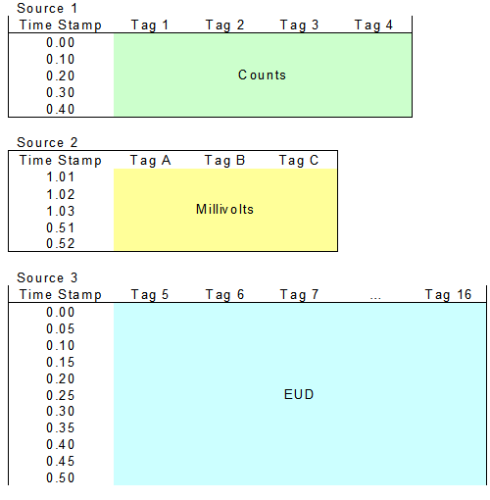
Circular Buffer
Data is in Raw units (lowest available from Source)
Independent per Source
Timestamps per Source
Sized per Source according to Capture Rate
This buffer has filled once and has started to overwrite the oldest samples.

Slide 37
Circular Buffer Process

Slide 38
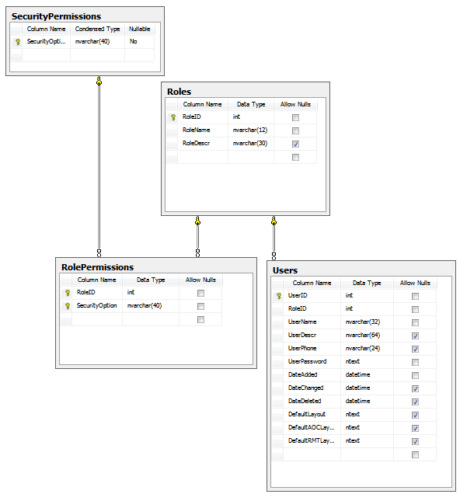
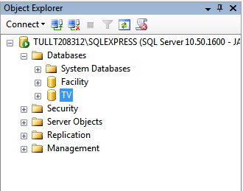
Test SLATE API Training
Database Basics

Slide 39
Facility Database
Contains
Sensor Configuration
Calibration History
Primary and Secondary Unit Information
Primary units are also referred to as ‘Calibration Units”. “Secondary Units” can be selected in the tag editor for display and reporting purposes; conversion factors are applied to the “Calibration Units” to convert to “Secondary Units”. This is useful for displaying temperature in Deg F for example for a device that would normally read in Deg C.
There is currently no user interface in Test SLATE for entering engineering units – they are entered directly into the Facility database using Microsoft SQL Server Management Studio.

Slide 40
TV Database
Contains
Source Information
Channel and Tag Information
Command and PC Information
Automated Test Definitions
Data Storage and other Settings

Slide 41
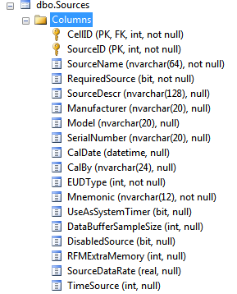
TV Database – Source Tables
Every Source is added to the Table
Keyed by Cell (System) and Source ID
EUD Type determines conversions applied
Counts, Intermediate, EUD
Mnemonic is the type of Source.
Must be defined in dbo.Mnemonics
DataBufferSample Size and SourceDataRate used to determine Circular Buffer Size

Slide 42
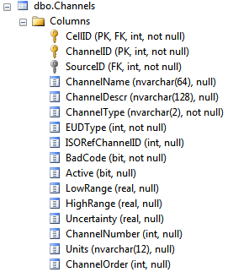
TV Database – Channel Tables
Every Channel is added to the Table
Keyed by Cell (System), Channel ID, and Source ID
EUD Type determines conversions applied
Counts, Intermediate, EUD
Units and Ranges are carried over to Tags
ChannelOrder can be used to control the order of the Tags in a Configuration

Slide 43
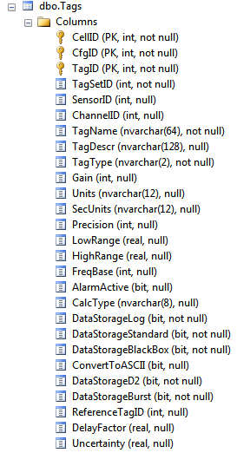
TV Database - Tags
Every Tag is added to the Table
Keyed by Cell (System), Cfg ID, and Tag ID
Source channels will also have Channel IDs defined
Added and defined by the Tag Editor

Slide 44
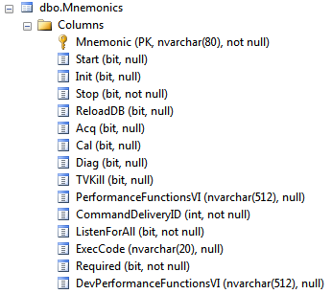
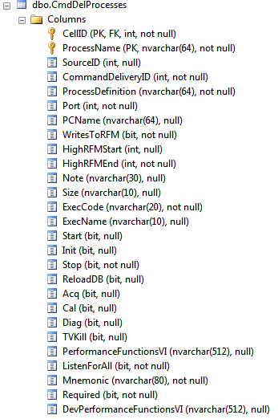
TV Database – Commands to Sources
Source Types are defined in Mnemonics table
As Sources are added individual entries are added to dbo.CmdDelProcesses
Defaulted to Mnemonics
Multiple instances of a Source may be invoked

Slide 45
Test SLATE API Training
Creating a New Source

Slide 46
General Test Information
Item | Description | Global Location
Test SLATE Path | The installation path for Test SLATE. | TestVIEW Paths Global.vi: TestVIEW Path
Data Files Path | The base path that Data Storage will use to store Data Directories. | TestVIEW Paths Global.vi: Data Files Path
Run Definition | The Run Definition name loaded. | TestVIEW Paths Global.vi: Current Test Number
Configuration Description | The description of the Configuration loaded. | TestVIEW Paths Global.vi: Test Description
Running Configuration | The name of the Configuration loaded. | TestVIEW Paths Global.vi: Running Configuration
MOC Node Name | The computer name of the MOC. | TestVIEW Paths Global.vi: Node Name
MSLog Port | The TCP/IP port at which the Message Log is listening for new messages. | MOC Message Global.vi: MSLOG Port
Cell ID | The ID in the Test SLATE database of the current System loaded. | RunSet
CfgID | The ID in the Test SLATE database of the current Configuration loaded. | RunSet
TestID | The ID in the Test SLATE database of the current Run Definition loaded. | RunSet
Source Names | Contains the list of Sources in the current test, in the order in which they will appear in all lists including Reflective Memory. | Instrument Information.vi: Source Name

Slide 47
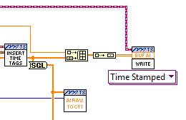
LabVIEW Source and Tag Classes
Objects contain RunSet information pertaining to Sources and Tags
Automatically generated by the Template for use
Source object used for most template inputs
Replaces need for Device Index
Contains CVT index and Data Type information
Contains Data Storage interface information
Brown Source Object wire
simplifies interface to the
Data Storage Circular Buffers

Slide 48
Error Cluster
Unhandled Error - Set this to true when you have an error condition. The Error Handler will set it to false once the error has been sent to the Message Log.
Error Status – Set this to true when you have an error condition.
Error Code – Enter the code for your error. The code must be listed in the message Codes.xls workbook.
Error Source – Enter the VI where the error is generated.
Severity – Select how serious the error or message is. When Emergency is selected, the user at the MOC will get a dialog box displaying the message.
Message Type – Select the type of message. Options are Code or Text. Always use Code for errors.
Number of Values – Error Handler automatically fills this in.
Msg Value Type – Enter the list of the types of values that you need to insert into the message. Options are Integer (1), Real (2), and String (3). The entries should match the order in the message.

